Slide 1
Suicide Prevention in the Military
5 October 2023
Dr. Ramya Sundararaman
Deputy Director
Defense Suicide Prevention Office

Slide 2

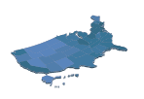

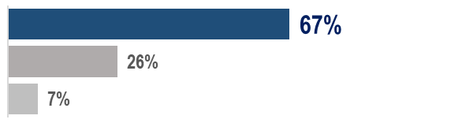
CY 2021 | Service Member Key Data
Suicide Rates per 100,000
  Active Component suicide rates gradually increased since 2011 despite significant prevention work, although 2021 suicide rates were lower than 2020
  Reserve & Guard suicide rates fluctuate year-to-year but there is no increasing/decreasing trend 2011-2021
24.3
  Active Component
  Service members
21.2
  Reserve
  Service members
26.4
  National Guard
  Service members
  Since 2011, military suicide rates have been similar to the U.S. population in most years
  (Accounting for age & sex differences since military is younger & mostly male)
Suicide Counts
519
  Service members died by suicide
  328 Active | 74 Reserve | 117 Guard
Most Common Method | Firearm
  Most Service members that died by suicide are young, enlisted males 20-24
  (consistent with prior years)
Active Component Suicide Deaths
Firearm
Hanging/Asphyx.
All others
74% Reserve
76% Guard
38% of suicide deaths occurred on military installation
(16% in barracks)
Notes:
DSPO is drafting the CY22 Annual Suicide Report as we speak and will be publicly available in October 2023. Can only speak to data for CY2021.

Slide 3

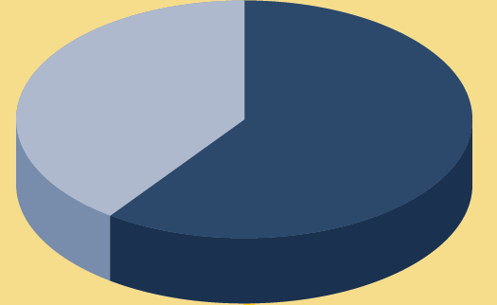
CY 2020* | Family Member Key Data
*Family member data lags 1 year based on sourcing from CDC*
Suicide Rates per 100,000
7.7
  The suicide rates for military spouses and dependents in 2020 were similar to prior years
  All Military Family members
  7.9 AC | 8.4 R | 6.5 NG
13.0
  Spouses
  13.0 AC | 15.0 R | 11.1 NG
4.3
  Suicide rates for spouses & dependents are similar to the U.S. population when accounting for age & sex differences, except for male spouses who had a higher rate
  Dependents (minor & non-minor)
  4.4 AC | -- R | -- NG
Suicide Counts
202
  Family members died by suicide
  133 Spouses | 69 Dependents
Most Common Method | Firearm
  SPOUSES
  DEPENDENTS
  60% Spouses
  55% Dependents
  51% female
  79% under 40 yrs
  47% current or prior military service
  73% male
  62% under 18 yrs
  <5% current or prior military service
(21% Hanging/Asphyx.)
(38% Hanging/Asphyx.)

Slide 4




A Social-Ecological Theory of Mental Health
Goal: Promote mental wellness using an integration of general and population-specific risk and protective factors
Individual
Identifies biological & personal history factors that affect mental health
Prevention requires understanding all these factors influence mental health
Relationship
Examines close relationships that may increase the risk factors
Community
Explores the settings in which social relationships occur
Societal
Broad societal factors that help create a climate in which mental health may occur

Slide 5
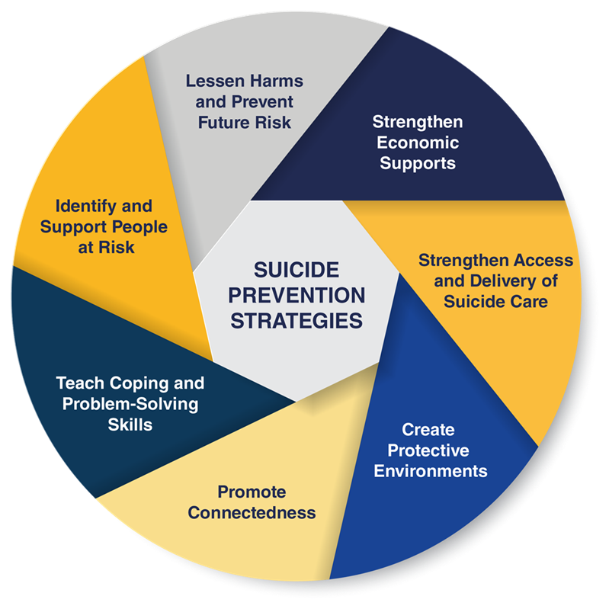
Public Health Approach
Because no two people or life experiences are the same, DOD approaches mental health by comprehensively enhancing protective factors and addressing risk factors.
Only 44% of CY21 suicide deaths had a history of mental health diagnosis (18% alcohol-related disorders)
Only 42% had received mental health care in the previous year
36% experienced significant relationship and family problems
21% experienced significant workplace difficulties
20% experienced significant legal and administrative stressors
DoD integrates a holistic approach to suicide prevention, intervention, and postvention that combines community and clinical interventions.
Notes:
This slide speaks to the public health approach – which involves creating products, policies, communications that speak to diverse audiences at multiple levels and considers all the issues that interact with suicide prevention
Using the public health approach leads to more effective, consistent and connected messaging – every outreach, campaign, toolkit, fact sheet strengthens the messaging web. Every added thread, reinforces the whole – the approach is effective because it is systemic, comprehensive

Slide 6
Department of Defense
Secretary of Defense
Office of the Inspector General of the Department of Defense
Office of the Secretary of Defense
Department of the Army
Department of the Navy
Office of the Air Force
Joint Chiefs of Staff
Deputy Secretary of Defense, Under Secretaries of Defense, Assistant Secretaries of Defense, and other specified officials
The Army
The Navy
The Marine Corps
The Air Force
The Space Force
Combatant Commands
9* DoD Field Activities including DHRA, administrative lead of DSPO
20* Defense Agencies
DSPO
*Accurate as of Oct. 26, 2022, via WHS DoD and OSD Component Heads issuance
Notes:
Slide included to show where DSPO fits into the greater DOD structure.
This also demonstrates that within the DOD hierarchy, DSPO does not have direct authority over the services.
DSPO must engage in partnership with services to attain goals.

Slide 7
DoD Suicide Prevention and Mental Health Efforts
FOSTERING A SUPPORTIVE ENVIRONMENT
Fielding a dedicated and specialized prevention workforce
Reducing risk through SM wellness, such as the SEP22 memo “Taking Care of Our Service Members and Families”
On-Site Installation Evaluations (OSIEs) to examine installation capabilities and risk factors
PROMOTING A CULTURE OF
LETHAL MEANS SAFETY
Lethal Means Safety Suite of Tools to promote safe storage of firearms, medication, and other lethal means
Counseling on Access to Lethal Means (CALM) to equip support providers to promote lethal means safety
ADDRESSING STIGMA AS A BARRIER TO
HELP-SEEKING
Working group to address stigma toward help-seeking
Review to identify and eliminate stigmatizing language in DoD policy
Education on availability and benefits of support resources
IMPROVING CLINICAL SERVICES
Suicide Risk Screening in all Primary Care Clinics
Suicide Risk Core Training for All Healthcare Providers
Notes:
Opportunity to highlight our prevention efforts and open discussion around various SP efforts.

Slide 8

SPRIRC Report
Secretary Austin directed 10 immediate actions on 16 March 2023, and established the Suicide Prevention Implementation Working Group (WG) under USD(P&R) to assess the remaining recommendations for advisability and to create initial estimates as to the cost, manpower, policy, or program changes required to implement.
DSPO has been tasked to oversee the implementation of the Suicide Prevention and Response Independent Review Committee (SPRIRC) recommendations.
Notes:
Detailed presentation by Dr. Hoyt
Introduce and discuss DSPO’s Role – how SPRIRC will evolve DSPO’s Mission

Slide 9



The Defense Suicide Prevention Office (DSPO)
MISSION
Advancing holistic, data-driven suicide prevention in our military community through policy, oversight, and engagement to positively impact individual beliefs and behaviors, as well as instill systemic culture change.
VISION
Unwavering pursuit of a mission-ready, suicide-free military community.
VALUES
Holistic; Innovative; Data-Driven; Collaborative; Integrity
Notes:
BACKGROUND: The Defense Suicide Prevention Office (DSPO) was established in 2011 as a result of recommendations from the Secretary of Defense-designated Defense Health Board Task Force, which was tasked to examine efforts to prevent military suicide. Two policies – ​DoD Instruction (DoDI) 6490.16, “Defense Suicide Prevention Program” and 6400.09, “Integrated Primary Prevention” – outline the roles and responsibilities of DSPO.

Slide 10









DSPO’s Journey
DSPO tasked to oversee SPRIRC implementation
2023
DoDI 6490.16 published
Provided the first comprehensive guidance for the Department’s suicide prevention and resilience efforts
Tomorrow
Implemented the Defense Suicide Prevention Directive 6490.14, signed
June 2013 by the DepSecDef
2022
“As we look to the future, our vision is to be a hub of hope.”
SPRIRC launched and is tasked with reviewing Dept’s efforts to address & prevent suicide
2019
2016
Annual Suicide Report becomes the official source for suicide counts
DSPO Established
as a result of an IRC to prevent military suicide, SPARRC transitioned to DSPO
2013
Defense Strategy for Suicide Prevention (DSSP) signed
2015
2011
Notes:
2011: DSPO established as a result of an IRC to prevent military suicide, SPARRC transitioned to DSPO
2013:Implemented the Department of Defense Directive 6490.14, “Defense Suicide Prevention Program,” signed June 2013 by the Deputy Secretary of Defense
2015: Defense Strategy for Suicide Prevention (DSSP) signed
2016: DoDI 6490.16 is published first Department-wide policy that provides comprehensive guidance for the Department’s suicide prevention and resilience efforts.
2019: Department of Defense (DoD) Annual Suicide Report (ASR) becomes the release authority for the official annual suicide counts and unadjusted rates for the DoD
2022: Suicide Prevention and Response Independent Review Committee (SPRIRC), launched in CY 2022. The SPRIRC is tasked with reviewing the Department's efforts to address and prevent suicide, visit multiple installations, conduct additional information gathering, and make recommendations to reduce suicide at the installations reviewed.
2023: DSPO to oversee implementation

Slide 11





Comprehensive Approach
GENERAL OBJECTIVES
DSPO aims to create comprehensive prevention, response, and postvention training resources, to lead surveillance and data analysis efforts, to translate research into practice, to promote partnerships, and to effectively communicate that life is worth living.
We meet the evolving needs of the military system by collaborating with internal and external stakeholders to create relevant, data informed policy and products.
AREAS OF FOCUS
Suicide Prevention Policy,
Guidance & Congressional
Strategic Integration & Reporting
Research Translation & Program Evaluation
Partnerships, Engagement & Training
Integrated Primary Prevention

Slide 12
Stigma Reduction
Policy Review for Stigmatizing Language
Messaging Promoting Help-seeking
Outreach Events
Promoting Access to Care

Slide 13







Service Member to Veteran Transition
DoD partners with VA on an overarching transition framework for Service members about to separate or retire from the military.
Begins a year before separation/retirement and continues through a year after service.
To our Veterans: You represent the best of our country. We have a solemn duty to take care of you. The Department of Defense continue[s] to partner with the Department of Veterans Affairs to ensure the transition to civilian life is as seamless as possible for everyone serving today.
- Secretary of Defense Lloyd Austin
Transition Assistance Program (TAP) - Service members receive one-on-one initial counseling & complete an assessment to help identify their personal transition needs
inTransition - free, confidential program that offers specialized coaching and assistance access to mental health care during times of transition
Separation health assessment - SMs complete a separation health assessment prior to discharge, which includes a mental health component to identify those at-risk
Additional support and warm handovers to the VA and others are provided to those identified in need or requesting additional help (no later than 90 days prior to their separation/retirement)
Notes:
The period when Service members separate or retire from the military can include multiple life adjustments (e.g. location, career, relationships, family roles, support systems, social networks, community, financial) that may increase their level of stress and risk.
Many overarching efforts aim to ensure a seamless military-to-civilian transition, thereby contributing to our overall suicide prevention efforts.
DoD works closely with VA to develop and support an overarching transition framework - which begins a year before separation/retirement and continues through a year after service.

Slide 14



Connecting you to your best MilLife

Slide 15
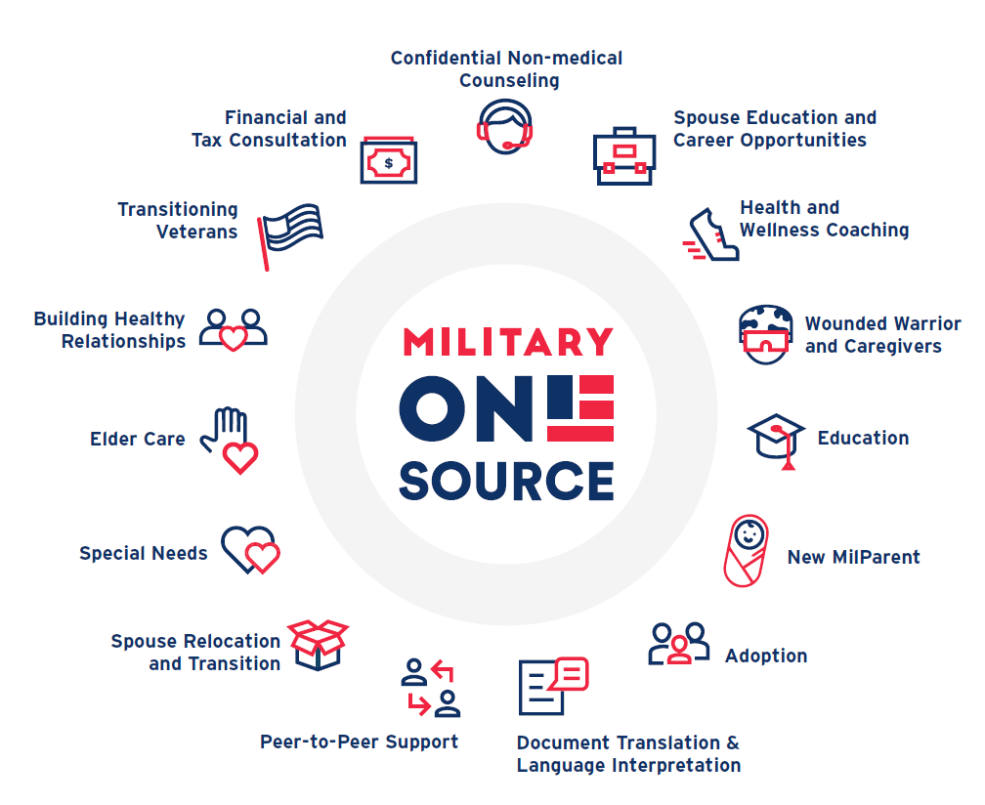
Comprehensive Range of Support
24/7/365 • www.MilitaryOneSource.mil • 800-342-9647

Slide 16


Access our support when, where and how it's convenient for you.
Call 800-342-9647
Live Chat
My Military OneSource App
MilitaryOneSource.mil
Notes:
Connect to Military OneSource and personalized support 24/7. You can call, CONUS or OCONUS, arrange a live chat, download the app for easy access on your phone.
And stay up to date by signing up for our newsletters and joining us on social media.
Social Networks
Find Military OneSource on:
Facebook
Twitter
Instagram
LinkedIn (SECO / MSEP)
Pinterest
YouTube

Slide 17

Questions?

