Slide 1
Veterans Health Administration
Preventing Veteran Suicide
Office of Mental Health & Suicide Prevention
Notes:
In 2005 – about 30,000 US Adults died by suicide (right around 84 per day)
Fifteen years later… in 2020, that number rose to around 46,00 and as of the CDC most recently released figures for 2021, and the rate rose to 48,000 US Adults (or on average around 132 US Adults every day).
US Adults:
48,183 people died by suicide in the United States
1 death every 11 minutes
12.3 million adults seriously thought about suicide
3.5 million adults made a plan
1.7 million adults attempted suicide
Of those roughly 132 US Adults per day, about 17 will be Veterans. And of those Veterans, 60% will not have gone to the VA for care at any point in the 2 years prior to their death.

Slide 2
Suicide in Context
Veteran suicide is a complex problem that cannot be addressed with a single solution, nor can it be addressed by VA or clinical intervention alone. VA is committed to a public health approach that includes both community prevention and clinical interventions.
Public Health Approach​
1
2
3
Suicide is preventable.
Suicide prevention requires a public health approach combining clinical and community-based approaches. ​
Everyone has a role to play in suicide prevention.
Notes:
The drivers of risk are complex and broad… and so to are the solutions. We know that intervention at one point changes trajectory. For the individual whose driver of risk is pain, pain management becomes a suicide prevention strategy.
VA operational analyses since 2007 have substantially advanced our understanding of Veteran suicide.
We have solid findings.
Veterans are at greater risk for suicide than non-Veteran US adults. In fact, Veterans are at a risk rate that is 57% higher than non-Veterans.
Veteran suicide deaths are more likely to involve firearms than suicide deaths among non-Veterans. As I’ll go over in a minute… not only are Veteran firearm rates significantly higher, the gap is growing wider.
Context matters – state variation in suicide rates in the general population are associated with state variation in rates among Veterans in VHA care. That means that not only are Veteran drivers of risk unique… but that additional distinctions within Veterans are also meaningful – for example, geographically remote Veterans, LGBTQ+, Asian American / Pacific Islanders, American Indian / Alaska Native Veterans, women Veterans <35, white male Veterans >55, survivors of military sexual trauma… and transitioning Veteran distinctions, all apply.
Among Veterans, suicide rates have increased substantially among younger Veterans.
Electronic health records include many markers of increased suicide risk, including screening, diagnostics, medication and treatment setting measures. It is important to assess how these findings may generalize to other health systems.

Slide 3
Overview
Veteran Suicide: Number
Veteran Suicide: Average Per Day
Veteran Suicide: Rate
6,146
16.8
31.7
per 100,000
Veteran suicide deaths in 2020
average number of Veteran suicides per day in 2020
unadjusted rate of suicide in 2020 among U.S. Veterans
Each year from 2001 through 2020, age- and sex-adjusted suicide rates of Veterans exceeded those of non-Veteran U.S. adults.
The difference in rates was greatest in 2017, when Veteran adjusted rates were 66.2% greater than those of non-Veteran adults. In 2020, this differential fell to 57.3%.

Slide 4
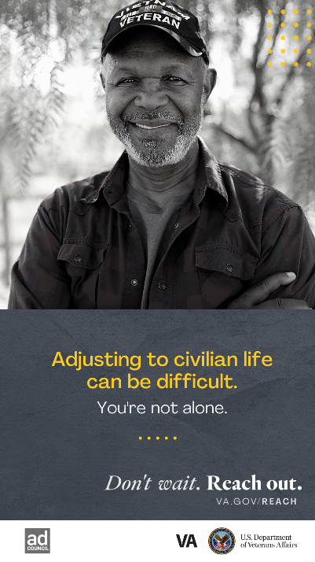
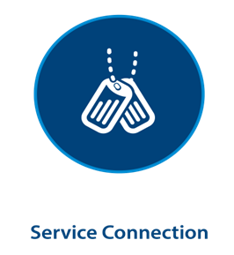
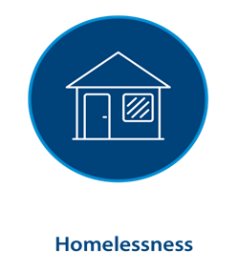
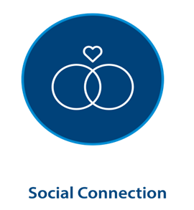
Narrowing the Focus on Drivers of Risk (Unique Veteran Factors)
Unassessed Service Connection
Homelessness
Food Insecurity
Legal Support
Lower employment
Lower income
Sleep Disorders
Pain
TBI | mTBI
Cancer (2.5 x)
Divorced
Widowed
Never Married
Loss of Community (transitioning Veterans)
Notes:
Economic Disparities: Veterans enrolled in VHA care are less likely to be employed and have, on average, lower levels of income than those outside of VHA care.
Service Connection: VHA user Veterans with service connected services have a lower risk than other VHA patients
Homelessness: Veterans struggling with housing insecurity (homelessness) are at higher risk of suicide
Social Connection: Suicide rates are highest among Veterans that are divorced, widowed, or never married.
Health and Well-being: Sleep disorders, pain, and TBI are associated with higher risks of suicide. Veterans with certain cancer diagnoses are 2.5 x higher risk than those without.
Age- and sex-adjusted suicide rates for Veterans were 57.3% higher than for non-Veteran US adults in 2020.
Suicide has many causes and the increased rate among Veterans may reflect factors related to entry into military service and to experiences prior to, during, and after military service.
Among Veterans, suicide rates are associated with many factors, including demographic, social, diagnostic, contextual, service branch, service exposures, housing, and health care utilization indicators. Further work is needed on community, occupational, and economic factors.

Slide 5
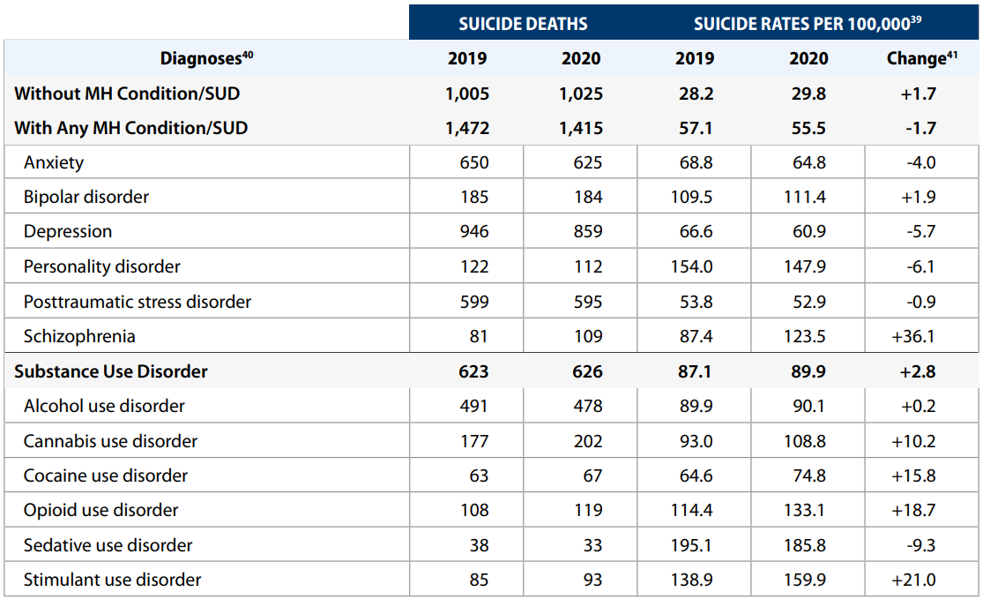
Suicide Deaths and Rates Among Recent Veteran VHA Users, by Mental Health and SUD Diagnoses, 2019 and 2020
Notes:
VHA mental health or SUD diagnoses were documented for 56.1% of Recent Veteran VHA Users who died from suicide in 2001 and for 58.0% of those who died in 2020.
Conversely, 42% of recent VHA Users who died from suicide in 2020 did not have a VHA mental health or substance use disorder diagnosis.
The suicide rate among cohorts of Recent Veteran VHA Users with mental health or substance use disorder diagnoses fell from 77.7 per 100,000 in 2001 to 55.5 per 100,000 in 2020. By contrast, the rate among Recent Veteran VHA Users who did not have documented mental health or SUD diagnoses rose from 25.6 per 100,000 in 2001 to 29.8 per 100,000 in 2020.

Slide 6
Suicide Deaths, Methods Involved, 2020 compared to 2001
 | Suicide by Methods Involved
 | Non-Veteran U.S. Adults |  | Veterans |  | Non-Veteran Men |  | Veteran Men |  | Non-Veteran Women |  | Veteran Women
 | 2020 | Change from 2001 | 2020 | Change from 2001 | 2020 | Change from 2001 | 2020 | Change from 2001 | 2020 | Change from 2001 | 2020 | Change from 2001
Firearms | 50.3% | -2.3% | 71.0% | +4.5% | 55.3% | -2.7% | 72.1% | +4.8% | 33.3% | -2.1% | 48.2% | +11.2%
Poisoning | 12.8% | -5.6% | 8.4% | -4.8% | 8.0% | -4.3% | 7.5% | -4.9% | 29.3% | -8.7% | 26.8% | -16.0%
Suffocation | 28.4% | +7.6% | 14.9% | +0.9% | 28.6% | +6.2% | 14.7% | +0.6% | 27.7% | +12.0% | 19.2% | +8.8%
Other | 8.4% | +0.3% | 5.8% | -0.6% | 8.1% | +0.8% | 5.8% | -0.5% | 9.6% | -1.1% | 5.8% | -3.9%
Notes:
Among U.S. adults who died from suicide in 2020, firearms were more commonly involved among Veterans (71.0%) than non-Veterans (50.3%).
In 2020, firearms were involved in 72.1% of suicides by male Veterans, up from 70.6% in 2019 and in 48.2% of suicides by female Veterans, down from 48.4% in 2019.
Among Veteran suicides
From 2001-2020:
Firearms increased +4.5%
Poisoning decreased -4.8%
Suffocation increased +0.9%
Other means decreased -0.6%

Slide 7
Staff Sergeant Parker Gordon Fox Suicide Prevention Grants
Nationally
2022 & 2023 Grants
Impacts
Georgia
One-year grant awards of up to $750,000 (totaling $52.5M per year)
Prioritization to areas with high concentrations of at-risk Veterans
18 – 34-year-old Veterans
Women Veterans <35
Minority Veterans
Geographically remote Veterans
Services include:
MH Screening for risk
Education
Provision of emergency care services
Case Management
Peer Support Services
Assistance connecting to benefits and care
Complementary services: service dogs, native treatments, equine therapy, family support circles, food security, resilience training, creative arts, etc.
Sept. 2022 – 80 grantees across 43 states, DC, and American Samoa
21 serving tribal lands (Navajo, Cherokee, Choctaw, Alaskan Native nations
Sept 2023 – 80 grantees across 43 states and 5 territories: Guam, Puerto Rico, US Virgin Islands, Northern Marianas, American Samoa), and DC
2024 – Preparing public Notice of Funding Opportunity.
Grantee service launch January 2023
15,800 engagements
Rural / Highly Rural
High Risk Veteran Populations
Approx. 6,000 referrals for suicide prevention services
300 Emergency Referrals
2,300 Non-Emergency Referrals
3,200 Social Service Referrals
Georgia Dept of State
Outreach, education, case management, benefits assistance and coordination
Highland Rivers Community Service Board
Cherokee and Pickens Counties, Outreach, education, clinical services, case management, peer support.
Northwest Florida Comprehensive Services for Children, Inc.
51 Counties (Outreach, education, case management, legal services, financial planning, transportation and childcare

Slide 8
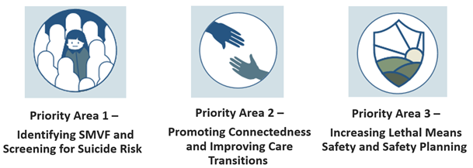
Governor’s / Mayor’s Challenge (STRONG ACT Sec. 303)
VA / SAMHSA / State partnerships to enhance and align state-wide suicide prevention efforts
Current partnering is all 50 states and 5 US territories. More than 1,500 active community coalitions
FY24 – FY26: award financial assistance to support the development and implementation of Suicide Mortality Review Committees to focus / guide local intervention needs.

Slide 9
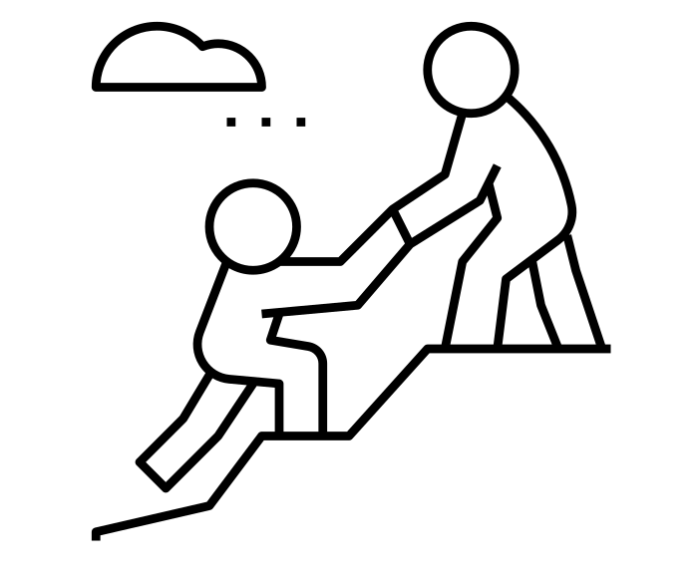
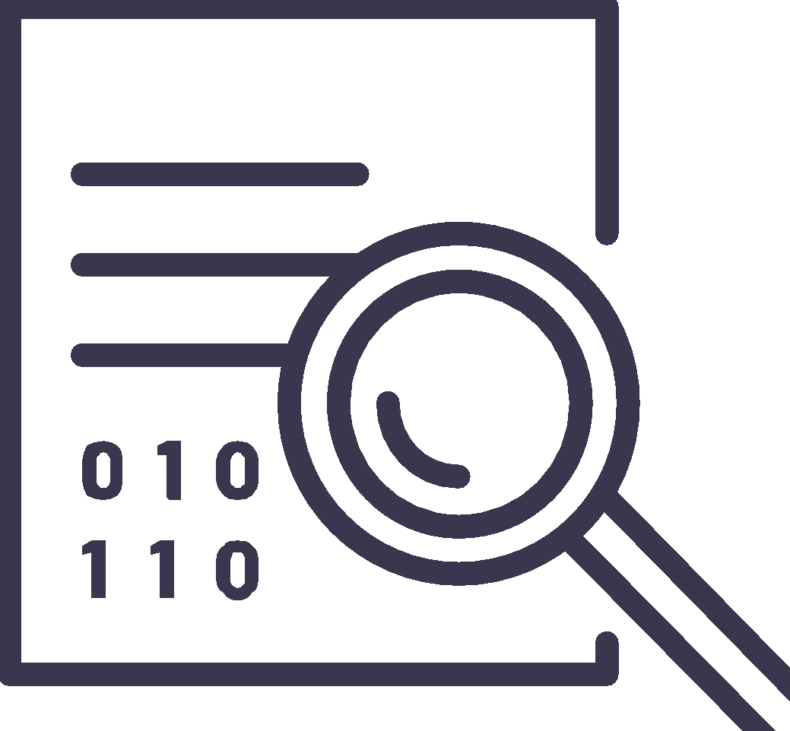
Mission Daybreak
National Innovations Grand Challenge (Call to Action)
Launched in May (2022) and final awards announced in February (2023). Received >1,300 concept submissions from Veterans, VSOs, health tech companies, community-based organizations, and universities.
Mentorship
30 finalist submissions were selected and awarded funding to scale proposals for testing to demonstrate impact in reducing Veteran suicide. These finalists were provided mentorship and funding to develop and test proposals.
Technology Partner Support
Solutions were geared towards (1) increasing lethal means safety (2) application of AI to identify individuals at risk for early intervention / prevention and (3) applications to increase access / engagement in care (including peer support engagements)
Finalist Selections
10 winners were selected: including AI technologies to train crisis line / front line responders, apps to provide comprehensive / integrated services to geographically remote and under-served Veterans (AI/AN), LMS technologies, peer support engagement platforms, predictive analytic applications, and more.
Advancing Opportunities
VA has begun pilots with several of these projects to test and scale solutions for outreach to high-risk Veteran populations (transitioning Veterans, geographically remote Veterans, minority Veterans, etc.).

Slide 10
Unadjusted Suicide Rate Per 100,000, Veterans, by Age Group, 2001-2020
From 2001 through 2020, the unadjusted suicide rate among Veterans:
Ages 18-34: | ↑95.3%
Ages 35-54: | ↑12.8%
Ages 55-74: | ↑58.4%
75 and older: | ↑21.2%
In 2001, Veterans between the ages of 35 and 54 had the highest suicide rates, among both Veteran men and Veteran women.
In 2020, suicide rates were highest among Veterans between the ages of 18 and 34 (both male and female Veterans) - increasing from 2019 to 2020, while for all other groups, rates decreased.

Slide 11
Unadjusted Suicide Rates, Veterans, by Race, 2001–2020
In 2020, the suicide rate was
14.2 per 100,000 among Black or African American Veterans.
29.8 per 100,000 among American Indians or Alaska Native Veterans; and
30.2 per 100,000 among Asian, Native Hawaiian or Pacific Islander Veterans;
34.2 per 100,000 among White Veterans;
In 2020, the suicide rate among White Veterans was more than twice the rate among Black or African American Veterans. From 2019 to 2020, rates decreased for Veterans in each category except Hispanic Veterans.

Slide 12
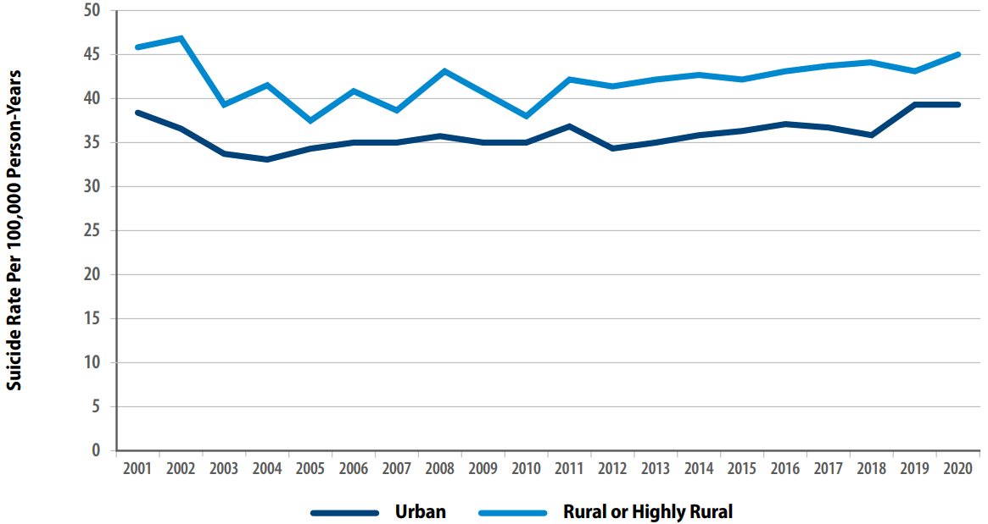
Unadjusted Suicide Rate Per 100,000 Person-Years, Recent Veteran VHA Users, by Urban, Rural or Highly Rural Status, 2001–2020
Among Veteran VHA Users, suicide rates were elevated for residents of rural areas, as compared to urban areas (Figure 16 below). For example, for individuals in rural or highly rural areas, the rate was 44.9 per 100,000 and it was 38.8 per 100,000 for those in urban areas. These differences may be partly attributed to demographic differences among Veteran VHA Users, by rurality status.⁴²

Slide 13
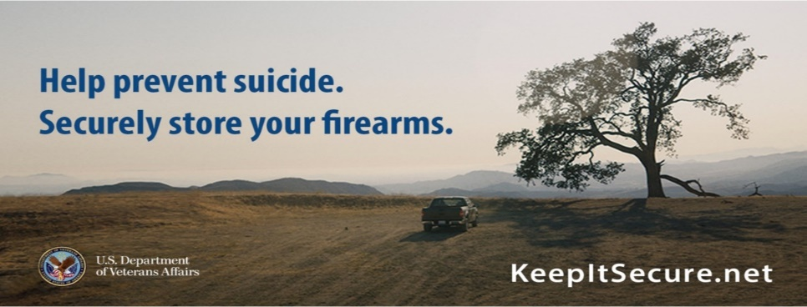
Lethal Means Safety Works
Reducing access to lethal suicide methods is one of the few population level interventions that has been shown to effectively decrease suicide rates.
Approximately 90 percent of people who survive a suicide attempt do not go on to die by suicide.
If we can collaborate with Veterans ahead of time to help them survive a suicidal crisis, we have likely prevented suicide for the rest of their lives.
Notes:
In 1997, Australia instituted stricter gun safety measures, including minimum age restrictions, psychological evaluations, background checks, and waiting periods. The firearm suicide rate steadily declined by 4.7% each year, and researchers did not see a substitution effect.
The Israeli Defense Force saw a 40% reduction in the suicide rate among soldiers when it restricted soldiers’ access to firearms during weekend leave.
Firearm-related suicides in Indiana and Connecticut declined after those states enacted legislation allowing law enforcement officers to seize firearms from individuals they deem a risk to themselves or others.
Full citations:
- Kapusta, N. D., Etzersdorfer, E., Krall, C., & Sonneck, G. (2007). Firearm legislation reform in the European Union: Impact on firearm availability, firearm suicide and homicide rates in Austria. The British Journal of Psychiatry, 191(3), 253–57.
- Lubin, G., Werbeloff, N., Halperin, D., Shmushkevitch, M., Weiser, M., & Knobler, H. Y. (2010). Decrease in suicide rates after a change of policy reducing access to firearms in adolescents: A naturalistic epidemiological study. Suicide and Life-Threatening Behavior, 40(5), 421–24.
- Kivisto, A. J., & Phalen, P. L. (2018). Effects of Risk-Based Firearm Seizure Laws in Connecticut and Indiana on Suicide Rates, 1981–2015. Psychiatric Services, 69, 855–62.

Slide 15
Resources for Veterans, Families, Peers, and other Supports

Slide 16
Free Training Resources | First Responders, Law Enforcement, Public Safety

Slide 17
Health Care Providers, Educators, and Clinicians

Slide 18
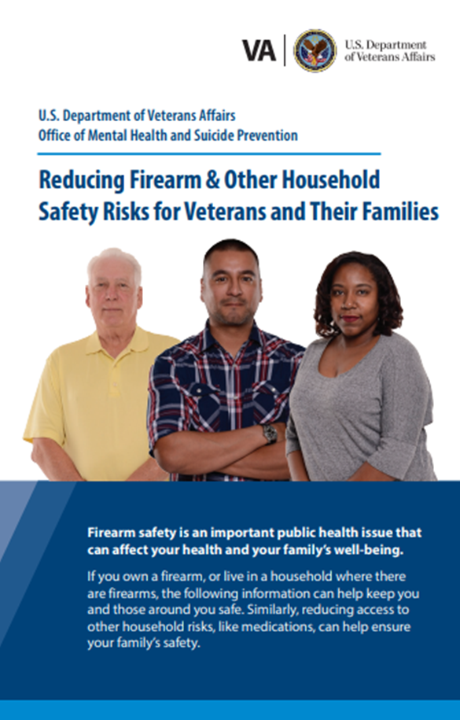
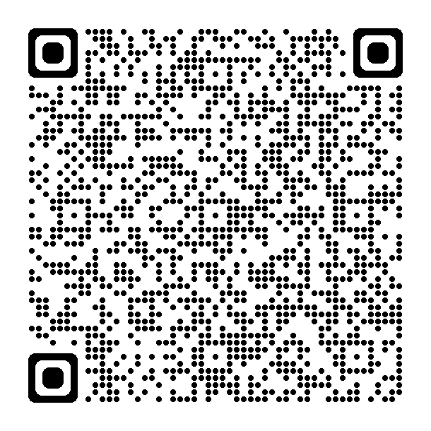
Lethal Means Safety Resources
Reducing Firearm & Other Household Safety Risks Brochure provides best practices for safely storing firearms and medications along with advice for loved ones on how to talk to the Veteran in their life about safe storage.
Normalize the discussion….
it’s OK to ask if someone is having thoughts about suicide. And it is OK to ask about how they are storing their firearms too.

Slide 19
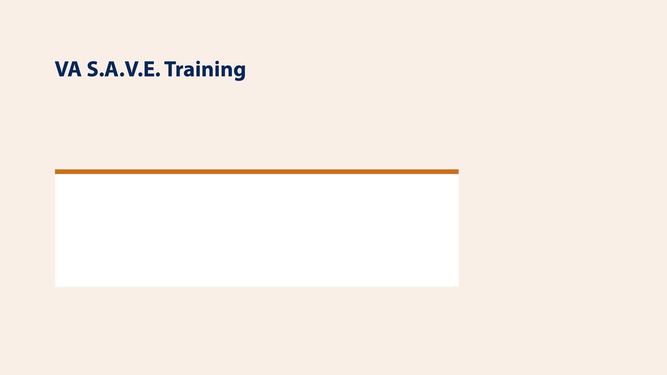
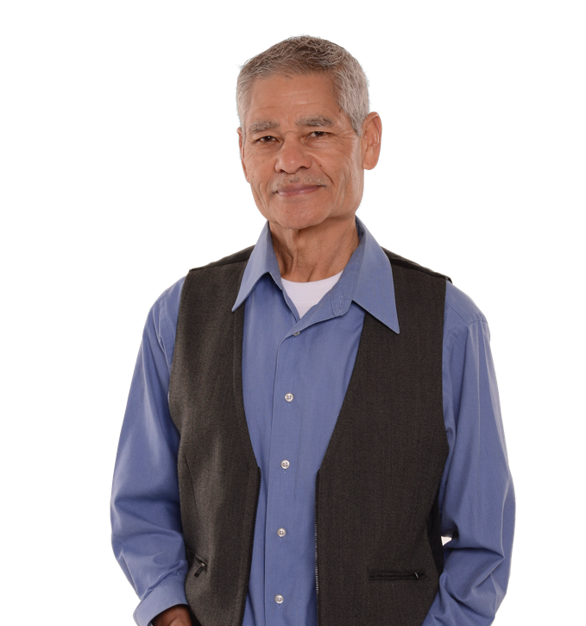
Training (Free)
This free suicide prevention training video is less than 25 minutes long and available to everyone, 24/7. It's offered in collaboration with the PsychArmor Institute.
Available online for free: https://psycharmor.org/courses/s-a-v-e/
Suicide in Military Members & Veterans
Crisis Response Plan: Introductory Course for People Who Support Veterans
Firearms & Suicide in the Military-Connected Community: 5 Things Medical Professionals Need to Know
Military Women: Women Who Serve (Psych/Armor)
What is the Crisis Response Plan: An Introductory Course for People Who Support Veterans
VA S.A.V.E. Preventing Caregiver Suicide

Slide 20
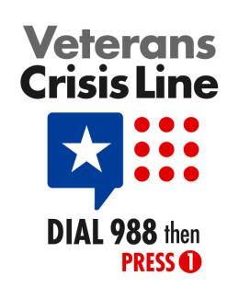
Free, Confidential Support 24/7/365
Veterans
Service Members
Family Members
Friends
Confidential crisis chat at VeteransCrisisLine.net/Chat or text 838255
Notes:
Veterans Crisis Line: The Veterans Crisis Line connects Veterans in crisis and their families and friends with qualified, caring VA responders through a confidential toll-free hotline, online chat, or text. Veterans and their loved ones can call dial 988 press 1, chat online, or send a text message to 838255 to receive confidential crisis intervention and support 24 hours a day, 7 days a week, 365 days a year. More information is available at https://www.veteranscrisisline.net/.

Slide 21
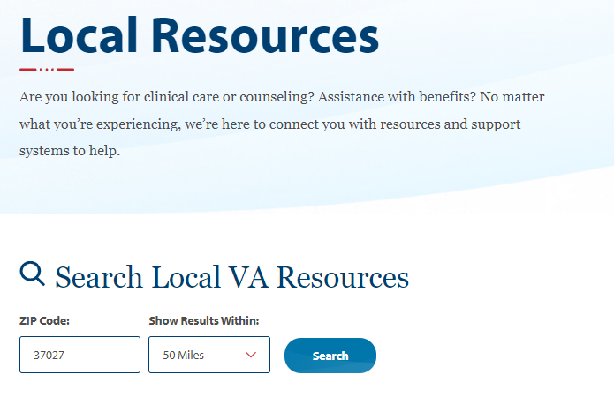
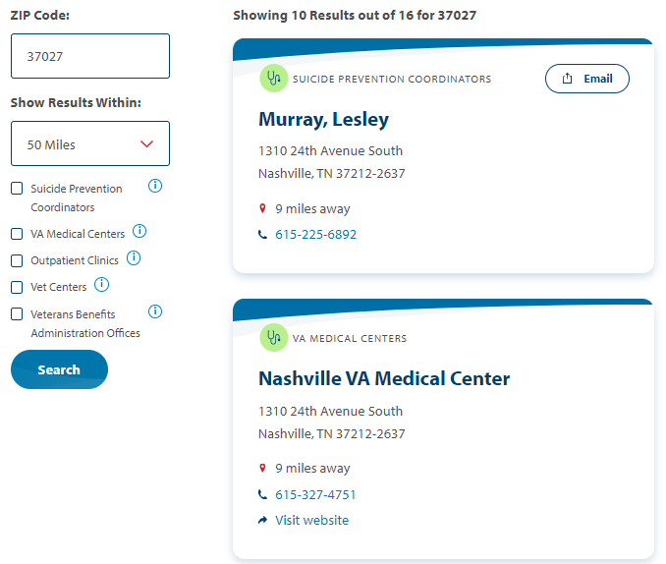
https://www.veteranscrisisline.net/find-resources/local-resources/
Notes:
After using the Resource Locator to find your local SPC, you can call or email them for clinical support, SAVE training, or event support. This example displays results of a search for resources in Fargo, North Dakota, which connects visitors to SPC Tammy Monsebroten, pictured here.

Slide 22
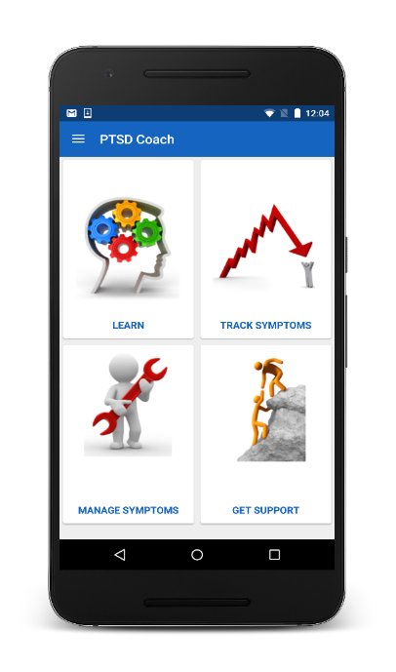
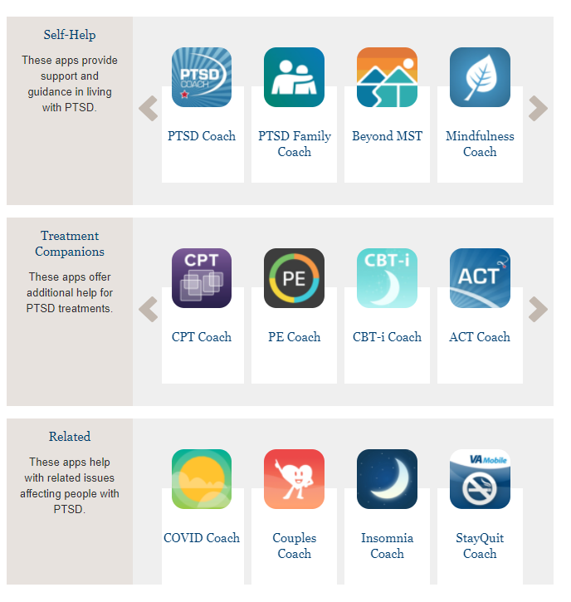
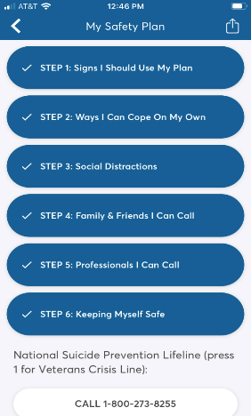
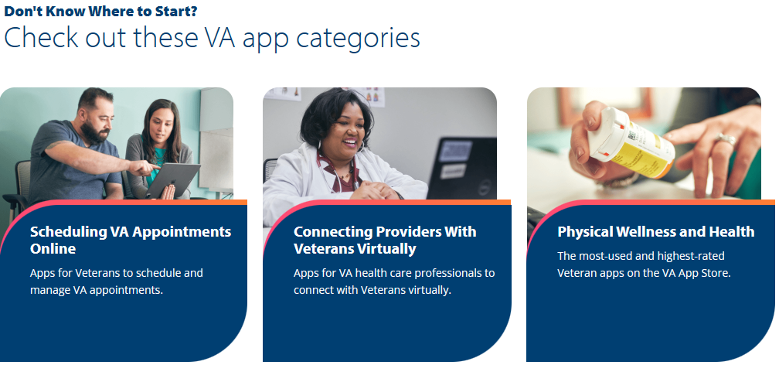
Mental Health Mobile Apps
App Store | VA Mobile
Mobile Apps (Free)
https://www.ptsd.va.gov/appvid/mobile/index.asp

Slide 23
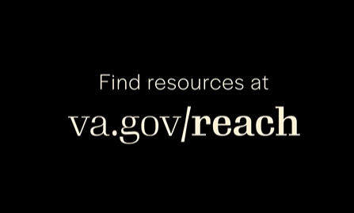
Suicide is preventable.
Notes:
Suicide is preventable, and preventive treatment works. Every day, people across the nation reach out for support and are able to live healthy, productive lives.

